Slide 1
Project ADA
Group Operations & Processes –
IT Strategy & Delivery
GHO
Reference Architecture
Internal

Slide 2
ARCHITECTURE AND COMPONENTS VIEW

Slide 3

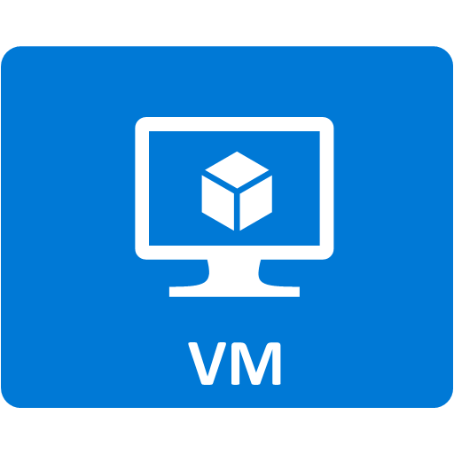





















ADA Architecture overall – AS IS
Azure Active Directory*
HTTPS
Azure Subscription
Data Management
Internet
ADA Enterprise Portal
Data Quality & Governance
HTTPS
FE
BE
HTTPS
Informatica
EDC
Informatica
Axon
Informatica**
DEQ
WAF
SFTP
Generali Network
Ingest & Process
TLS
Store
TLS
Data Engine Process
Business Information
Consumption
ON PREM
Certified Storage
Informatica Data
Engineering DEI**
TLS/HTTPS
Synapse
SQL Server
Databricks
HTTPS
PowerBi
Gateway
Static Reporting
Interactive Dashboard
HTTPS/TLS
HTTPS
Self-Service BI
HTTPS/TLS
HTTPS
Data Lake Storage
Self-Service Data Preparation
Informatica MDM
SFTP Server
/reference
SFTP
/staging/
HTTPS
HTTPS
/landing/
Sources (other)
* Azure Active Directory managed by GOSP Infrastrucutre
** Both services are on the same IaaS server
HTTPS

Slide 4
ARCHITECTURE VIEW PER SERVICES
ITCF-APP-0258 Opti.Mo System
ITCF-APP-0214 Passthrough TEAM Tool (Data hub IFRS17)
ITCF-APP-0215 Data hub IFRS9
ITCF-APP-0216 Data Quality & Governance (DDT)
ITCF-APP-0217 GCFO Datalake
ITCF-APP-0241 ECDM
ITCF-APP-0271 Annual Integrated Reporting (AIR)
ITCF-APP-0286 IDQS Dashboard

Slide 5
Architecture for services Datahub IFRS9 & IFRS17
Azure Active Directory*
HTTPS
Azure Subscription
Data Management
Internet
ADA Enterprise Portal
Data Quality & Governance
HTTPS
FE
BE
HTTPS
Informatica
DEQ**
WAF
SFTP
Generali Network
Ingest & Process
TLS
Store
TLS
Present
Data Engine Process
ON PREM
Certified Storage
Informatica Data
Engineering DEI**
TLS/HTTPS
SQL Server
Databricks
HTTPS
SAP S/4HANA
HTTPS/TLS
HTTPS/TLS
HTTPS
Data Lake Storage
/reference/quality
/reference
SFTP Server
/staging/quality
SFTP
/staging/
HTTPS
/landing/
Sources (other)
* Azure Active Directory managed by GOSP Infrastrucutre
** Both services are on the same IaaS server

Slide 6
Architecture for service Opti.Mo
Azure Active Directory*
HTTPS
Azure Subscription
Data Management
Internet
ADA Enterprise Portal
Data Quality & Governance
HTTPS
FE
BE
HTTPS
Informatica
DEQ**
WAF
SFTP
Generali Network
Ingest & Process
TLS
Store
TLS
Present
Data Engine Process
ON PREM
Certified Storage
Informatica Data
Engineering DEI**
TLS/HTTPS
SQL Server
Databricks
HTTPS/TLS
HTTPS/TLS
HTTPS
Data Lake Storage
/reference/quality
/reference
SFTP Server
/staging/quality
SFTP
/staging/
HTTPS
/landing/
Sources (other)
* Azure Active Directory managed by GOSP Infrastrucutre
** Both services are on the same IaaS server

Slide 7
Architecture for service AIR
Azure Active Directory*
HTTPS
Azure Subscription
Data Management
Internet
ADA Enterprise Portal
Data Quality & Governance
HTTPS
FE
BE
HTTPS
Informatica
DEQ**
WAF
SFTP
Generali Network
Ingest & Process
TLS
Store
TLS
Present
Data Engine Process
ON PREM
Certified Storage
Informatica Data
Engineering DEI**
TLS/HTTPS
SQL Server
Databricks
HTTPS/TLS
HTTPS/TLS
HTTPS
Data Lake Storage
/reference/quality
/reference
SFTP Server
/staging/quality
SFTP
/staging/
HTTPS
HTTPS
/landing/
Sources (other)
* Azure Active Directory managed by GOSP Infrastrucutre
** Both services are on the same IaaS server

Slide 8
Architecture for service Data Quality & Governance (DDT)
Azure Active Directory*
HTTPS
Azure Subscription
Data Management
Internet
ADA Enterprise Portal
Data Quality & Governance
HTTPS
FE
BE
HTTPS
Informatica
EDC
Informatica
Axon
Informatica
DEQ**
WAF
SFTP
Generali Network
Ingest & Process
TLS
Store
TLS
Present
Data Engine Process
ON PREM
Certified Storage
Informatica Data
Engineering DEI**
TLS/HTTPS
SQL Server
Databricks
HTTPS/TLS
HTTPS/TLS
HTTPS
Data Lake Storage
/reference/quality
/reference
SFTP Server
/staging/quality
SFTP
/staging/
HTTPS
/landing/
Sources (other)
* Azure Active Directory managed by GOSP Infrastrucutre
** Both services are on the same IaaS server

Slide 9
Architecture for service GCFO Datalake & Reporting
Azure Active Directory*
HTTPS
Azure Subscription
Data Management
Internet
ADA Enterprise Portal
Data Quality & Governance
HTTPS
FE
BE
HTTPS
Informatica
Axon
Informatica
DEQ**
WAF
SFTP
Generali Network
Ingest & Process
TLS
Store
TLS
Present
Data Engine Process
TLS/HTTPS
Business Information
Consumption
ON PREM
Certified Storage
Informatica Data
Engineering DEI**
Synapse
SQL Server
Databricks
HTTPS
PowerBi
Gateway
Static Reporting
Interactive Dashboard
HTTPS/TLS
HTTPS
Self-Service BI
HTTPS/TLS
HTTPS
Data Lake Storage
Self-Service Data Preparation
/reference/quality
/reference
/staging/quality
/staging/
HTTPS
/landing/
Sources (other)
* Azure Active Directory managed by GOSP Infrastrucutre
** Both services are on the same IaaS server
HTTPS

Slide 10
Architecture for service IDQS
Azure Active Directory*
HTTPS
Azure Subscription
Data Management
Internet
ADA Enterprise Portal
Data Quality & Governance
HTTPS
FE
BE
HTTPS
WAF
Synapse
(Spark)
SFTP
Generali Network
Ingest & Process
Store
Present
Data Engine Process
TLS/HTTPS
Business Information
Consumption
ON PREM
Certified Storage
Synapse
HTTPS
PowerBi
Gateway
Static Reporting
Interactive Dashboard
HTTPS/TLS
Synapse
(Data Factory)
HTTPS
Self-Service BI
HTTPS/TLS
HTTPS
Data Lake Storage
Self-Service Data Preparation
/reference/quality
/reference
/staging/quality
/staging/
HTTPS
/landing/
Sources (other)
* Azure Active Directory managed by GOSP Infrastrucutre
HTTPS

Slide 11
Architecture view per ECDM
Azure Active Directory*
HTTPS
Azure Subscription
Data Management
Internet
Data Quality & Governance
HTTPS
WAF
Informatica
Axon
SFTP
Generali Network
Ingest & Process
Store
Present
Data Engine Process
ON PREM
Certified Storage
HTTPS/TLS
Data Lake Storage
Sources (other)
* Azure Active Directory managed by GOSP Infrastrucutre
HTTPS

Slide 12










Subnet segregation and type of resources
ghovnet
appgwghosn 10.200.45.0/24
Infra3 10.200.44.64/27 (non production)
Infra5 10.200.44.128/27 (production)
infra4 10.200.44.96/27 (non production)
private endpoints
private endpoints
infra6 10.200.44.160/27 (production)
sn_dbksada_prod_priv 10.200.46.0/26
sn_dbksada_prod_pub 10.200.46.64/26
dei + deq
axon
sftp
dei + deq
axon
sftp
Production
edc
mdm
portal
edc
mdm
portal
private endpoints
private endpoints
sn_dbksada_cert_priv 10.206.5.0/26
sn_dbksada_cert_pub 10.206.5.64/26
Dev machines
gateway pbi
gateway pbi
Non production

Slide 13

Resource Groups distribution
CFO_ADA_Certification_rg: Resource group where are stored all the core resource for ADA non production environment
CFO_ADA_Certification_backup_rg_1: Resource group where are stored backup resources of vm and sql server instance in non production environment
Certification
databricks-rg-cfoadadatabrickscert-suf3gssa34gcs: Resource group where are stored all resource of databricks certification components
synapseworkspace-managedrg-7321987e-9fca-459c-accb-f3e1334421b0: Resource group where are stored all synapse certification managed vnet components
rg-managed-cfoadasyndev01: Resource group where are stored all synapse development managed vnet components
CFO_ADA_Production_rg: Resource group where are stored all the core resource for ADA production environment
CFO_ADA_Production_backup_rg_1: Resource group where are stored backup resource of vm and sql server instance in production environment
Production
databricks-rg-cfoadadatabricksprod-qx2yrluoakbec: Resource group where are stored all resource of databricks production components
synapseworkspace-managedrg-bccc3873-18fa-45af-b812-7fa801d6f010: Resource group where are stored all synapse production managed vnet components
databricks-rg-cfoadadatabricksdr-akgrs7gxlq7ns: Resource group where are stored all resource of databricks production components
synapseworkspacedr: Resource group where are stored all synapse production DR managed vnet components

Slide 14

ADA IaaS - Production

Slide 15
ADA IaaS – Certification

Slide 16

ADA SaaS: Synapse view
ghovnet
cfoadasyndev01 (managed vnet)
infra4 10.200.44.96/27 (non production)
infra3 10.200.44.64/27 (non production)
cfoadastudiohubdev01_pep – 10.200.44.103
Development
cfoadasyndev01_pepdev – 10.200.44.110
cfoadasyndev01_pepsql – 10.200.44.111
cfoadasyndev01_pepsqlondemand – 10.200.44.109
ghovnet
cfoadasyncert01 (managed vnet)
infra4 10.200.44.96/27 (non production)
infra3 10.200.44.64/27 (non production)
cfoadastudiohubcert01_pep – 10.200.44.103
Certification
cfoadasyncert01_pepdev – 10.200.44.102
cfoadasyncert01_pepsql – 10.200.44.100
cfoadasyncert01_pepsqlondemand – 10.200.44.101
cfoadasynprod01 (managed vnet)
ghovnet
infra6 10.200.44.160/27 (production)
infra5 10.200.44.128/27 (production)
Production
cfoadastudiohubprod01_pep – 10.200.44.167
cfoadasynprod01_pepdev – 10.200.44.166
cfoadasynprod01_pepsql – 10.200.44.164
cfoadasynprod01_pepsqlondemand – 10.200.44.165

Slide 17


ADA SaaS: Purview view
NOT CREATED
Certification
REMOVED
ghovnet
cfoadapurviewprod01 (managed vnet)
infra6 10.200.44.160/27 (production)
infra5 10.200.44.128/27 (production)
cfoadapurviewprod01_pepaccount – 10.200.44.170
Production
cfoadapurviewprod01_pepportal – 10.200.44.170
cfoadapurviewprod01-default-blob – 10.200.44.169
cfoadapurviewprod01-default-queue – 10.200.44.171
cfoadapurviewprod01-default-namespace – 10.200.44.171

Slide 18
ADA SaaS: Databricks view
ghovnet
Infra4
sn_dbksada_cert_priv 10.206.5.0/26
sn_dbksada_cert_pub 10.206.5.64/26
Certification
databricks_ui_api - 10.200.44.108
ghovnet
Infra6
sn_dbksada_prod_priv 10.200.46.0/26
sn_dbksada_prod_pub 10.200.46.64/26
Production
databricks_ui_api - 10.200.44.168

Slide 19
ADA SaaS: Storage account view
ghovnet
infra3 10.200.44.64/27 (certification)
cfoadaadslgen2dlcert_pepadfs – 10.200.44.84
Certification
cfoadaadslgen2dlcert_pepblob – 10.200.44.81
cfoadaadslgen2dlcert
cfoadaadslgen2dlcert_pepfile – 10.200.44.88
ghovnet
Infra5 10.200.44.128/27 (production)
cfoadaadslgen2dlprod_pepadfs – 10.200.44.141
Production
cfoadaadslgen2dlprod_pepblob – 10.200.44.139
cfoadaadslgen2dlprod
cfoadaadslgen2dlprod_pepfile – 10.200.44.145

Slide 20

ADA PaaS: Automation account view
ghovnet
infra3 10.200.44.64/27 (certification)
infra4 10.200.44.96/27 (certification)
pe-ada-automationaccount-cert-webhook – 10.200.44.112
Certification
pe-ada-automationaccount-cert-hybridworker – 10.200.44.113 / 10.200.44.114
ada-automationaccount-cert
ghovnet
Infra5 10.200.44.128/27 (production)
infra6 10.200.44.160/27 (production)
Production
pe-ada-automationaccount-prod-webhook – 10.200.44.170
ada-automationaccount-prod
pe-ada-automationaccount-prod-hybridworker – 10.200.44.172 / 10.200.44.176

Slide 21


ADA SaaS: SQL Elastic pool view
ghovnet
Infra3 10.200.44. 64/27 (production)
ADA_ENETRPRISEPORTAL_CERT
INFADBDEV
Certification
repos-infa
infa
INFADBDEV_bck
INFA_DB
INFAEDC105
edc-database – 10.200.44.85
repos-infa-pool
INFADBCERT
ghovnet
Infra5 10.200.44.128/27 (production)
ADA_ENETRPRISEPORTAL_PROD
EDC_DOM_PROD
EDC_RWH_PROD
Production
repos-infa-prod
EDC_105_PROD
EDC_MON_PROD
EDC_WKF_PROD
EDC_ASSET_PROD
EDC_MRS_PROD
INFADBPREPROD
database-ada-privateendpoint – 10.200.44.146
repos.-infa-prod-pool
EDC_DOC_PROD
EDC_PWH_PROD
INFADBPROD

Slide 22




ADA SaaS: Application Gateway view
Self-signed certificate
Signed by Global Sign
ghovnet
appgwghosn
Infra5 / infra3 (production/non production)
ada-preprod.generali.com
Issued by Global Sign
HTTPS – 443 port
vm-preprod-enterpriseportal-01-idm
*.generali.com
Issued by Global Sign
ada.generali.com
Issued by Global Sign
ada.generali.com
Issued by Global Sign
HTTPS – 443 port
vm-prod-enterpriseportal-01-idm
ada-axon.generali.com
Issued by Global Sign
HTTPS – 9443 port
vm-prod-infa-axn-01-idm
ada-cert.generali.com
Issued by Global Sign
HTTPS – 443 port
vm-cert-enterpriseportal-01-idm

Slide 23
SYSTEM MONITORING

Slide 24
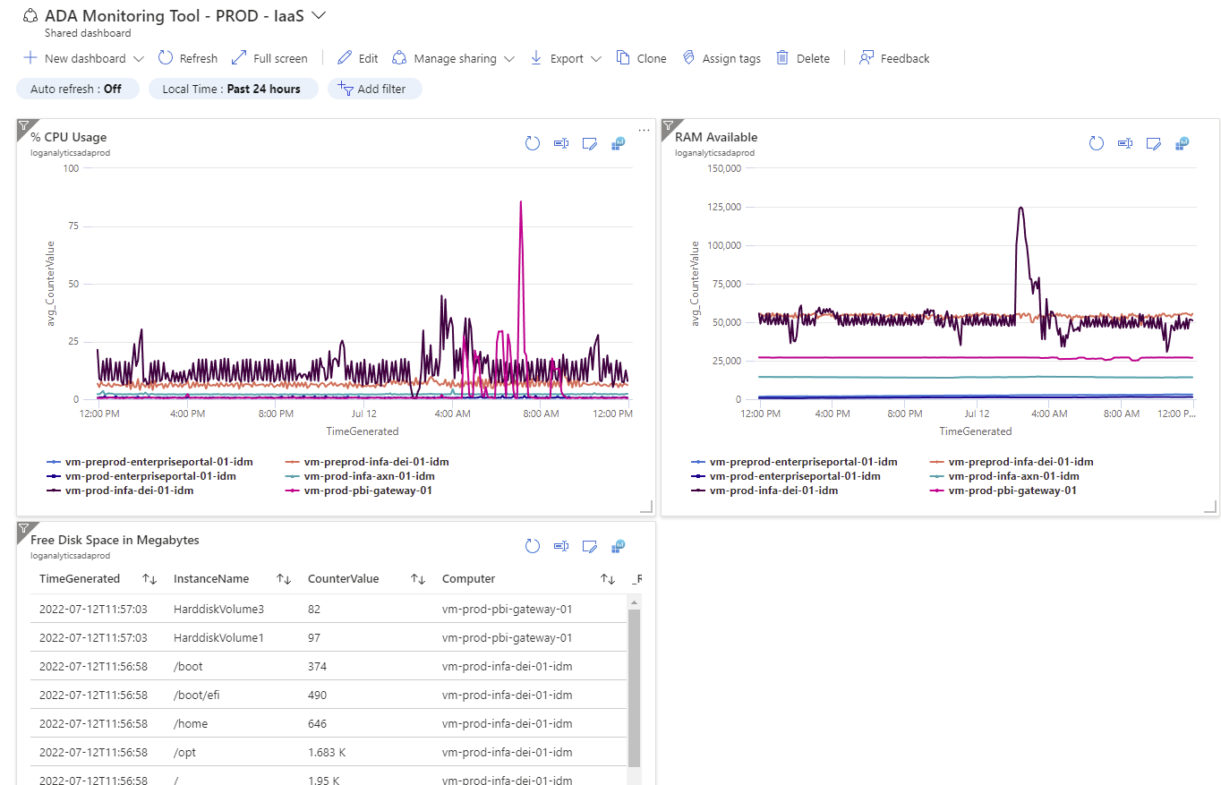
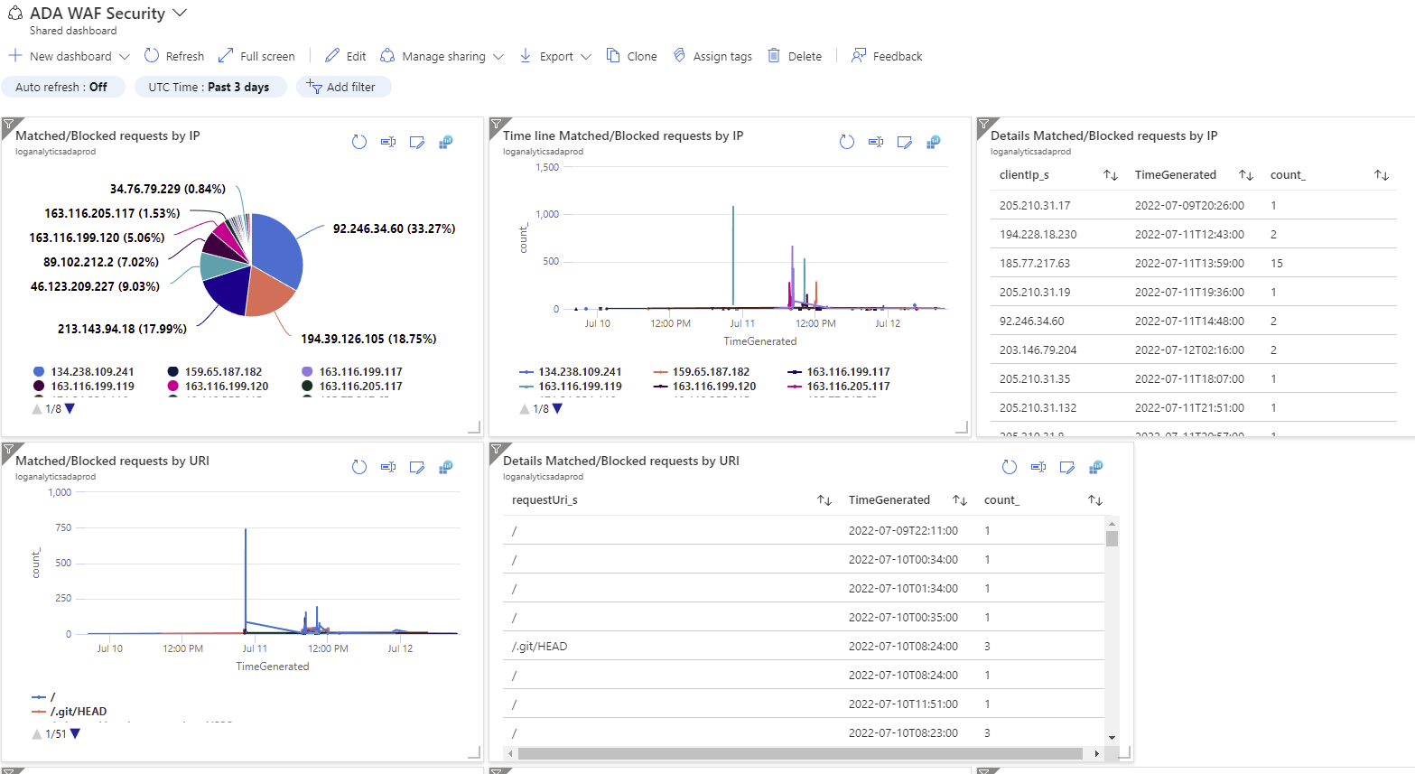
Monitoring - Infrastructure
Risorse monitorate:
- Sia ambiente di produzione che ambiente di non produzione
- Sia infrastruttura di tipo IaaS che PaaS/SaaS
IaaS Monitoring
PaaS/SaaS Monitoring
Transition to New Relic
WIP
Sono stati configurati per ogni ambiente (prod e non-prod) 14 server IaaS collegati direttamente al servizio SaaS Azure Log Analytics.
Le principali informazioni raccolte in Azure Log Analytics sono %CPU di utilizzo, memoria disponibile e spazio disco disponibile con una retention di 30 giorni.
Soglie implementate per la segnalazione via mail e attivazione del team AMS di NTT sono:
% CPU media nell’arco di 1 minuto sopra il 90% per più di 10 volte nell’arco della giornata
% media di memoria disponibile nell’arco di 10 minuti sopra il 90% per più di 10 volte nell’arco della giornata
Spazio disco medio nell’arco di 2h oltre la soglia del 85%
Sviluppate delle dashboard specifiche per i vari ambienti screenshot di esempio qui sotto.
Sono stati configurati per ogni ambiente (prod e non-prod) dei monitoraggi anche sui varie risorse PaaS/SaaS di azure adottate da ADA come lo Storage Account (alias Datalake), Azure Application Gateway e Azure SQL elastic pool. Attività ancora da completare invece per quanto riguarda lo strumento Synapse.
Non tutte le risorse sono state agganciate a Azure Log Analytics come per la parte IaaS. Ad esempio Azure SQL elastic pool è stato salvato in un altro datalake di appoggio per questione di costi e volumi generati, è possible comunque con azure monitor e dashboard custom monitorare le DWH che sono una unità di misura specifica di microsoft, combinazione di cpu e spazio memoria, che indica il livello di consumo della risorsa.
Sono state definite le seguenti soglie di monitoraggio che pssono generare una mail di alert verso l’ams di NTT:
SQL elastic pool soglia impostata per l’unita di misura DWH al 90% sull’intera risorsa al 40% su ogni singola istanza di database
Storage Account soglia impostata sulla latenza del network superior ai 45 millisecond, inoltre segnala se vengono superate le 50 transazioni in errore nell’arco della giornata (tipo di errori timeout, authorization error, client other error)
Alert ancora da impostare per l’application gateway e synapse
Sviluppate delle custom dashboard per le risorse, Sql Elastic pool, Application gateway e Storage acount. Qui sotto dashboard di esempio per monitoraggio dei tentative di intrusion sul firewall WAF dell’application gateway da internet.
Strumenti adottati:
Azure Log Analytics: serve per la raccolta delle informazioni e lo storage dei dati raccolti e da analizzare
Azure Monitoring with Email Alert: strumento messo a disposizione da microsoft per tracciare e monitorare i log presenti in Azure Log Analytics, che al verificarsi di superamento di soglie pre-impostate invia una mail di segnalazione al supporto AMS
Dashboard custom: dashboard preconfezionate per una maggior efficacia delle analisi in fase di troubleshooting di un eventuale problema verificato

Slide 25
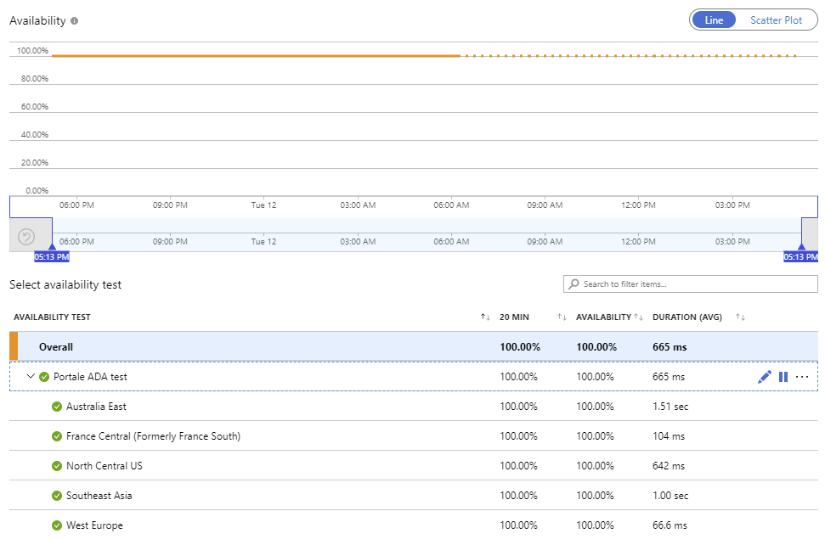

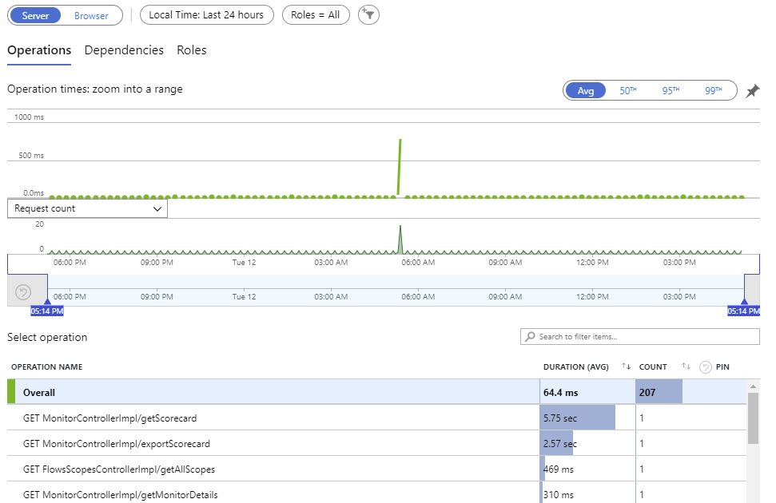
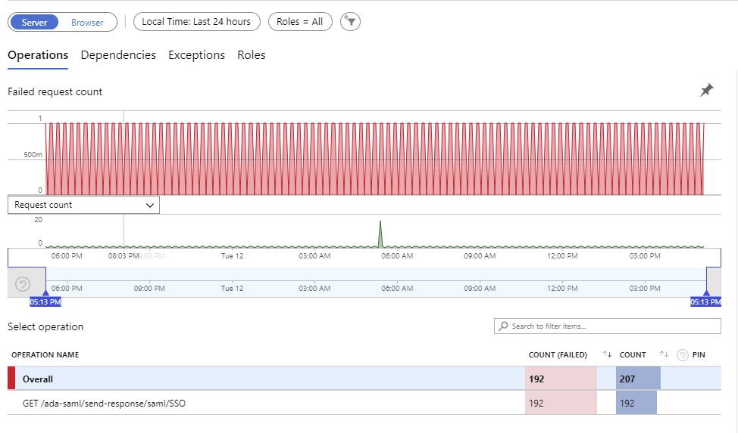
Monitoring - Application
Risorse monitorate:
- Sia ambiente di produzione che ambiente di non produzione
- L’applicazione monitorata è “Enterpise ADA Portal”
ADA Enterprise Portal
Sono stati configurati per ogni ambiente (prod e non-prod) il servizio azure insight per il monitoraggio dell’applicazione ADA Enterprise Portal, con possibilità di monitoraggio realtime e alert nel caso in cui portale non è raggiungibile con il servizio di availability.
Gli aspetti applicativi da monitorare con questo strumento sono:
Live metrics monitoraggio realtime del carico della macchina come “Incoming request”, “Outgoing Request”, Committed Memory, % CPU, Exception Rate
Availability del portale da differenti regioni del mondo e latenza di risposta del ping con invio alert email quando non disponibile al gruppo AMS che si attiva per la risoluzione
Application Failure per il monitoraggio dele eccezioni generate dall’applicativo
Performance per il monitoraggio dei tempi di riposta di determinate chiamate
Transition to New Relic
Strumenti adottati:
Application Insight ed alerts: serve a collezionare I log applicative come eccezioni, utenti connessi, tempi di risposta di applicativi web, log custom generati dall’applicativo, verifica raggiungibilità e latenza dell’applicativo web da diverse region nel mondo.
Availability
Performance
Failure

Slide 26
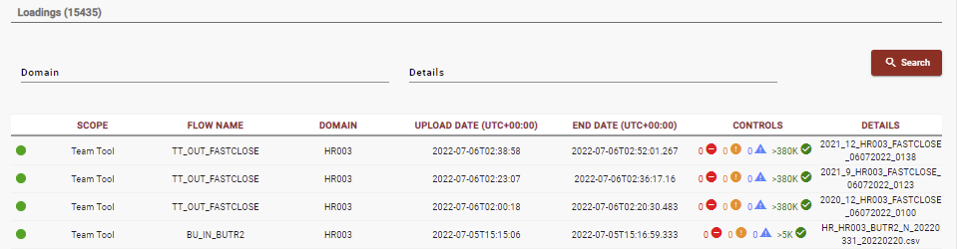
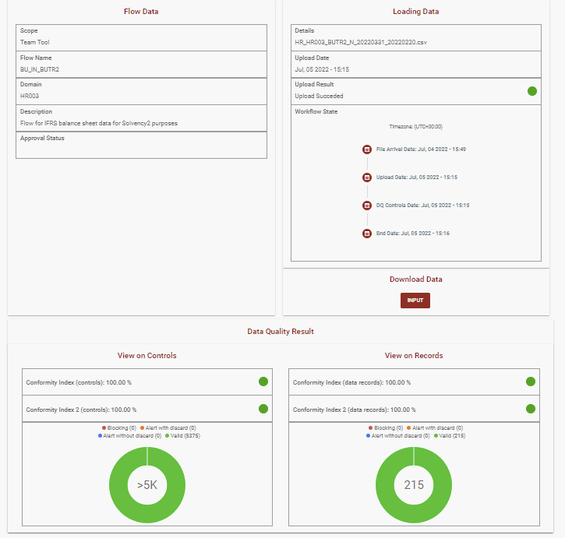
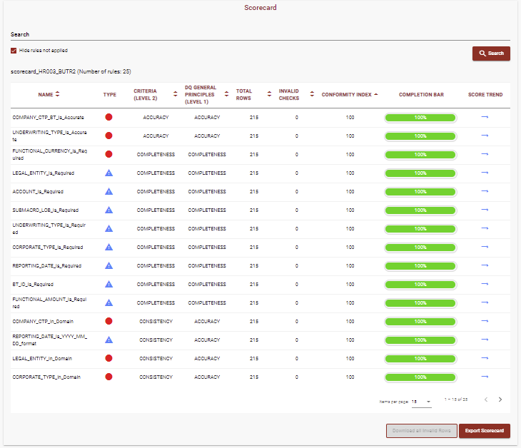
Monitoring – Operations
Lista esecuzioni flussi input/output
ADA Datahub for TEAM Tool / ADA Datahub IFRS9
Sono stati implementati una serie di flussi dati in ingresso e uscita dal Sistema sia per il processo IFRS17/TEAM Tool sia per il processo IFRS9.
Per un primo monitoraggio dei flussi sui processi NEXT ad uso e consumo delle local BU operative è stata messa a disposizione una sezione di monitoraggio per verificare il caricamento dei dati in ingreso o uscita con una serie di informazioni:
Risultati delle regole di qualita applicate sui dati input/ouput, definendo regole bloccanti, alert con scarto, alert senza scarto e relative indici di conformità nel rispetto delle policy di DQ
Data di caricamento del flusso, data avvio ed esecuzione del flusso, data esecuzione delle regole di qualità sui dati e orario conclusione del flusso.
Esito overoll del flusso sulla singola esecuzione
Trend della data quality sulla tipologia di flusso
Risorse monitorate:
- Sia ambiente di produzione che ambiente di non produzione
Strumenti adottati:
ADA Enterprise Portal:
Interfaccia web per il montoraggio dei flussi in ingresso e in uscita del sistema ADA
Dettaglio scorecard del flusso
Dettaglio esecuzione flusso

Slide 27
DR on REGION NORTH EU

Slide 28







DR per AXON – Portal - PBI
WEB Browser
https://ada.generali.com
ENV : DEV
OS : Windows
SW : TBD
CPU : 8
RAM : 32
DISK : 512 Gb
Only for Test DR Purposes
DRAFT
VM Gateway PBI
VM Gateway PBI
OS : WindowsServer
CPU 8
RAM ➔ 32 GB
Reference documentation chapter
8. Configurazione DR per Gateway
OS : WindowsServer
CPU 8
RAM ➔ 32 GB
DISK OS 128 GB
DISK OS 128 GB
https://adacfotrafficgateway.trafficmanager.net
Manual replica
Reference documentation chapter
2. Configurazione Virtual Machine
and
9.5 Preparazione Test-failover Informatica AXON
Informatica Axon
Informatica Axon
A-P HDD replica
OS : RHEL 7.8 x64
CPU 16
RAM ➔ 128 GB
OS : RHEL 7.8 x64
CPU 16
RAM ➔ 128 GB
DISK OS 64 GB
Reference documentation chapter
3. Configurazione DR per il DB SQL SERVER
and
9.4 Preparazione Test-failover Custom app
DISK OS 64 GB
DISK 0 256 GB
DISK 0 256 GB
Azure Elastic Pool
Replica
On Demand Automatic GEO-replica
Azure Elastic Pool
Reference documentation chapter
2. Configurazione Virtual Machine
and
9.7 Preparazione Test-failover Custom app
Custom App
Azure Elastic Pool
Failover Group
Custom App
OS : RHEL 7.8 x64
CPU 16
RAM ➔ 128 GB
A-A Automatic GEO-replica
OS : RHEL 7.8 x64
CPU 16
RAM ➔ 128 GB
DISK OS 64 GB
A-P HDD replica
DISK OS 64 GB
DISK 0 512 GB
DISK 0 512 GB
Reference documentation chapter
7. Configurazione DR per KEY VAULT
West EU
Cross Region
North EU

Slide 29
DR per Data processing
Developer Client
Only for Test DR Purposes
DRAFT
ENV : DEV
OS : Windows
SW : TBD
CPU : 8
RAM : 32
DISK : 512 Gb
Azure Elastic Pool
Replica
Reference documentation chapter
3. Configurazione DR per il DB SQL SERVER
and
9.4 Preparazione Test-failover Custom app
Azure Elastic Pool
On Demand Automatic GEO-replica
A-A Automatic GEO-replica
Azure Elastic Pool
Failover Group
DEI/DEQ
DEI/DEQ
Reference documentation chapter
2. Configurazione Virtual Machine
and
9.5 Preparazione Test-failover Informatica AXON
OS : RHEL 7.8 x64
CPU 16
RAM ➔ 128 GB
https://adacfoinfadei01.trafficmanager.net
OS : RHEL 7.8 x64
CPU 16
RAM ➔ 128 GB
OS DISK 64 GB
A-P HDD replica
OS DISK 64 GB
DISK 0 256 GB
DISK 0 256 GB
DISK 1 64 GB
DISK 1 64 GB
Reference documentation chapter
2. Configurazione Virtual Machine
and
9.3 Preparazione Test-failover SFTP Server
SFTP server
SFTP server
https://adacfosftp01.trafficmanager.net
OS : RHEL 7.8 x64
CPU 16
RAM ➔ 128 GB
A-P HDD replica
OS : RHEL 7.8 x64
CPU 16
RAM ➔ 128 GB
Azure databricks
A-A Manual
Azure databricks
DISK OS 64 GB
DISK OS 64 GB
Reference documentation chapter
5. Configurazione DR Azure Databricks
Azure datalake gen2
Azure datalake gen2
A-A Automatic GEO-replica
(preview)
Reference documentation chapter
6. Configurazione DR per Storage Account
Azure Synapse
Azure Synapse
Manual GEO-Backup
Reference documentation chapter
4. Configurazione DR per Synapse
West EU
Cross Region
North EU

Slide 30
Architettura per Servizio

Slide 31
Data Discovery Tool
Power Automate
Teams
Imperva
Azure Application Gateway
Portale
(DDT & Monitoring)
Storage Account Datalake
Azure SQL
Synapse

Slide 32
GDPP Dashboard
GRC
GDPP
Imperva
Azure Application Gateway
Portale
(NEW Monitoring)
Storage Account Datalake
ADF
Azure SQL
Databricks
Power BI

Slide 33
NEXT: Passthrough TEAM Tool (Datahub IFRS17)
SAP FPSL
SFTP
Imperva
Azure Application Gateway
Portale
(Monitoring)
Storage Account Datalake
TEAM Tool
Azure SQL
Informatica

Slide 34
NEXT: Datahub IFRS9
Goanywhere
Imperva
Azure Application Gateway
Portale
(Monitoring)
Storage Account Datalake
ADM
Azure SQL
Informatica
Moody’s

Slide 35
NEXT: AIR
Power Automate
Teams
Imperva
Azure Application Gateway
Portale
(AIR & Monitoring)
Storage Account Datalake
Azure SQL
Informatica

Slide 36
NEXT: Opti.Mo
Power Automate
Teams
Imperva
Azure Application Gateway
Portale
(Opti.Mo & Monitoring)
Storage Account Datalake
Azure SQL
Synapse
Power Bi

Slide 37


Microsoft Enhanced Scenario : Focus on components, PROD
Metadata Management (MM)
Data Management (DM)
Application and Services
Data Lineage +
Metadata Intelligence
DM : Data Quality
MM : Data Directory,
Data Elements,
Rules Management
Semantic Framework
Bulk / Batch ETL
Master Data
Management
Informatica
Enterprise Data Catalog
Informatica
DEI, DEQ
Informatica
MDM
DEVELOPMENT VMs
ENV : PROD/IDM
OS : Linux redhat 7.8
SW :
CPU : 16
RAM : 64
DISK : 512 Gb
Informatica
AXON
ENV : PROD
OS : Linux redhat 7.8
SW :10.4.1.3
CPU : 16
RAM : 128
DISK : 384 Gb
ENV : PROD
OS : W2016 Srv Ent.
SW :ND
CPU : 8
RAM : 32
DISK : 256 Gb
Num1
Num1
Num1
ENV : DEV
OS : Windows
SW : ND
CPU : 8
RAM : 32
DISK : 512 Gb
ENV : PROD
OS : Linux redhat 7.8
SW :7.2.2.2
CPU : 8
RAM : 32
DISK : 320 Gb
Num3
ENV : PROD/MDP
OS : Linux redhat 7.8
SW :ND
CPU : 16
RAM : 64
DISK : 1 Tb
Num1
Databricks Cluster
ENV : PROD
OS : Linux redhat 7.8
SW : 5.5 lts
CPU : 4
RAM : 14
DISK : ND
SQL Server
Num1
ENV : PROD
OS : W2016 Srv Ent.
SW :ND
CPU : 8
RAM : 32
DISK : 2 Tb
Num
10
Hadoop Cluster
Num1
ENV : PROD
OS : Linux redhat 7.8
SW :ND
CPU : 8
RAM : 32
DISK : 1 Tb
Num3
Custom Portal
Azure SQL
Azure Datalake
Web App
ENV : PROD
DISK : 3 Tb
Usage: 250 Gb
ENV : PROD
DISK : 5 Tb
Usage: 200 Gb
ENV : PROD
OS : Linux redhat 7.8
SW :7.2.2.2
CPU : 8
RAM : 32
DISK : 512 Gb
Num1
Num1
Num1

Slide 38
Microsoft Enhanced Scenario : Focus on components, PRE PROD
Metadata Management (MM)
Data Management (DM)
Application and Services
DM : Data Quality
MM : Data Directory,
Data Elements,
Rules Management
Semantic Framework
Bulk / Batch ETL
Master Data
Management
Informatica
Enterprise Data Catalog
Informatica
DEI, DEQ
Informatica
MDM
DEVELOPMENT VMs
ENV : PreProd/IDM
OS : Linux redhat 7.8
SW :NA
CPU : NA
RAM : NA
DISK : NA
Informatica
AXON
ENV : PreProd
OS : Linux redhat 7.8
SW :10.4.1.3
CPU : 8
RAM : 128
DISK : 384 Gb
ENV : PreProd
OS : W2016 Srv Ent.
SW :NA
CPU : NA
RAM : NA
DISK : NA
Num1
Num1
Num1
ENV : DEV
OS : Windows
SW : ND
CPU : 8
RAM : 32
DISK : 512 Gb
ENV : PreProd
OS : Linux redhat 7.8
SW :NA
CPU : NA
RAM : NA
DISK : NA
Num3
ENV : PreProd/MDP
OS : Linux redhat 7.8
SW :NA
CPU : NA
RAM : NA
DISK : NA
Num1
Databricks Cluster
SQL Server
Num1
ENV : PreProd
OS : Linux redhat 7.8
SW : 5.5 lts
CPU : 4
RAM : 14
DISK : ND
ENV : PreProd
OS : W2016 Srv Ent.
SW :ND
CPU : NA
RAM : NA
DISK : NA
Num
10
Num1
Hadoop Cluster
ENV : PreProd
OS : Linux redhat 7.8
SW :NA
CPU : NA
RAM : NA
DISK : NA
Num3
Custom Portal
Azure SQL
Azure Datalake
Web App
ENV : PreProd
DISK : 3 Tb
Usage: 250 Gb
ENV : PreProd
DISK : 5 Tb
Usage: 200 Gb
ENV : PreProd
OS : Linux redhat 7.8
SW :7.2.2.2
CPU : 8
RAM : 32
DISK : 512 Gb
Num1
Num1
Num1

Slide 39
Microsoft Enhanced Scenario : Focus on components, CERT
Metadata Management (MM)
Data Management (DM)
Application and Services
Data Lineage +
Metadata Intelligence
DM : Data Quality
MM : Data Directory,
Data Elements,
Rules Management
Semantic Framework
Bulk / Batch ETL
Master Data
Management
Informatica
Enterprise Data Catalog
Informatica
DEI, DEQ
Informatica
MDM
DEVELOPMENT VMs
ENV : CERT/IDM
OS : Linux redhat 7.8
SW :ND
CPU : 16
RAM : 64
DISK : 512 Gb
Informatica
AXON
ENV : CERT
OS : Linux redhat 7.8
SW :10.4.1.3
CPU : 16
RAM : 128
DISK : 384 Gb
ENV : CERT
OS : W2016 Srv Ent.
SW :ND
CPU : 8
RAM : 32
DISK : 256 Gb
Num1
Num1
Num1
ENV : DEV
OS : Windows
SW : ND
CPU : 8
RAM : 32
DISK : 512 Gb
ENV : CERT
OS : Linux redhat 7.8
SW :7.2.2.2
CPU : 8
RAM : 32
DISK : 320 Gb
Num3
ENV : CERT/MDP
OS : Linux redhat 7.8
SW :ND
CPU : 16
RAM : 64
DISK : 1 Tb
Num1
Databricks Cluster
ENV : CERT
OS : Linux redhat 7.8
SW : 5.5 lts
CPU : 4
RAM : 14
DISK : ND
SQL Server
Num1
ENV : CERT
OS : W2016 Srv Ent.
SW :ND
CPU : 8
RAM : 32
DISK : 2 Tb
Num
8
Hadoop Cluster
Num1
ENV : CERT
OS : Linux redhat 7.8
SW :ND
CPU : 8
RAM : 32
DISK : 1 Tb
Num3
Custom Portal
Azure SQL
Azure Datalake
Web App
ENV : CERT
DISK : 3 Tb
Usage: 250 Gb
ENV : CERT
DISK : 5 Tb
Usage: 200 Gb
ENV : CERT
OS : Linux redhat 7.8
SW :7.2.2.2
CPU : 8
RAM : 32
DISK : 512 Gb
Num1
Num1
Num1

Slide 40
Microsoft Enhanced Scenario : Focus on Acomponents, DEV
DRAFT
Metadata Management (MM)
Data Management (DM)
Application and Services
DM : Data Quality
MM : Data Directory,
Data Elements,
Rules Management
Semantic Framework
Bulk / Batch ETL
Master Data
Management
Informatica
Enterprise Data Catalog
Informatica
DEI, DEQ
Informatica
MDM
DEVELOPMENT VMs
ENV : DEV/IDM
OS : Linux redhat 7.8
SW :NA
CPU : NA
RAM : NA
DISK : NA
Informatica
AXON
ENV : DEV
OS : Linux redhat 7.8
SW :10.4.1.3
CPU : 16
RAM : 128
DISK : 384 Gb
ENV : DEV
OS : W2016 Srv Ent.
SW :NA
CPU : NA
RAM : NA
DISK : NA
Num1
Num1
Num1
ENV : DEV
OS : Windows
SW : ND
CPU : 8
RAM : 32
DISK : 512 Gb
ENV : DEV
OS : Linux redhat 7.8
SW :NA
CPU : NA
RAM : NA
DISK : NA
Num3
ENV : DEV/MDP
OS : Linux redhat 7.8
SW :NA
CPU : NA
RAM : NA
DISK : NA
Num1
Databricks Cluster
SQL Server
Num1
ENV : DEV
OS : Linux redhat 7.8
SW : 5.5 lts
CPU : 4
RAM : 14
DISK : ND
ENV : DEV
OS : W2016 Srv Ent.
SW :ND
CPU : NA
RAM : NA
DISK : NA
Num
10
Num1
Hadoop Cluster
ENV : DEV
OS : Linux redhat 7.8
SW :NA
CPU : NA
RAM : NA
DISK : NA
Num3
Custom Portal
Azure SQL
Azure Datalake
Web App
ENV : DEV
DISK : 3 Tb
Usage: 250 Gb
ENV : DEV
DISK : 5 Tb
Usage: 200 Gb
ENV : DEV
OS : Linux redhat 7.
SW :7.2.2.2
CPU : 8
RAM : 32
DISK : 512 Gb
Num1
Num1
Num1

